Slide 1



Seminar on
Final Results of 2011 Economic Census of Cambodia
Supported by :
Government of Japan, Japan International Cooperation Agency (JICA) and Government of Cambodia
National Institute of Statistics, Ministry of Planning
On 13-14 March 2012,at CJCC Phnom Penh, Cambodia

Slide 2
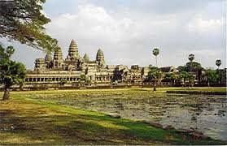
​ Financial Situation of Establishments
by industry
by KHIN SOVORLAK, DDG, NIS
Ministry of Planning, Cambodia

Slide 3
CONTENTS
1) Annual Sales by Section of Industrial Classification and Sex of Representative - Cambodia (2011)
2) Percent Distribution of Annual Sales by Section of Industrial Classification and Sex of Representative - Cambodia (2011)
3) Annual Sales per Establishment by Section of Industrial Classification and Sex of Representative - Cambodia (2011)
4) Proportion to Average Annual Sales per Establishment by Section of Industrial Classification and Sex of Representative - Cambodia (2011)

Slide 4
CONTENTS
5) Annual Sales per Person Engaged by Section of Industrial Classification and Sex of Representative - Cambodia (2011)
6) Proportion to Average Annual Sales per Person Engaged by Section of Industrial Classification and Sex of Representative - Cambodia (2011)

Slide 5
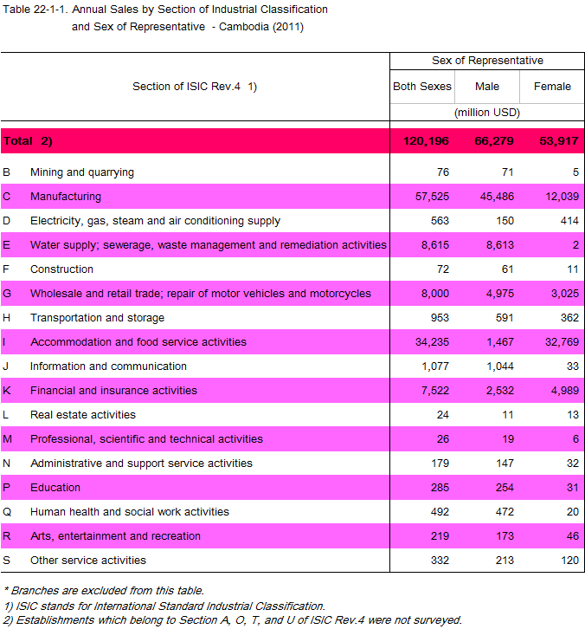

Slide 6
Annual Sales by Section of Industrial Classification and Sex of Representative - Cambodia (2011)
B. Mining and quarrying C. Manufacturing
D. Electricity, gas, steam E. Water supply;
F. Construction
G.Wholesale and retail
H.Transportation and
I. Accommodation and
J. Information and
K. Financial and
L. Real estate activities M.Professional,scientifiN. Administrative and
P. Education
Q. Human health and
R. Arts, entertainment
S.Other service activities

Slide 7
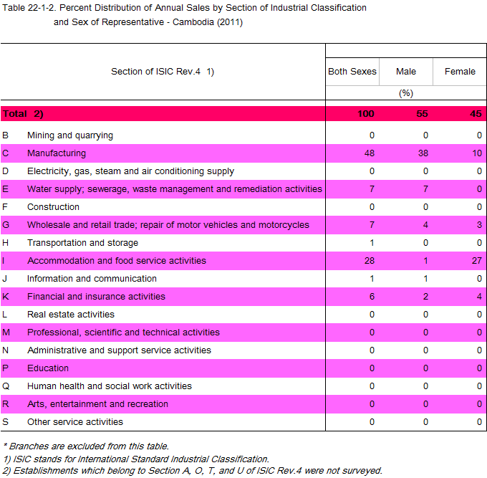

Slide 8
Percent Distribution of Annual Sales by Section of Industrial Classification and Sex of Representative - Cambodia (2011)
B. Mining and quarrying C. Manufacturing
D. Electricity, gas, steam E. Water supply;
F. Construction
G.Wholesale and retail
H.Transportation and
I. Accommodation and
J. Information and
K. Financial and
L. Real estate activities M.Professional,scientifiN. Administrative and
P. Education
Q. Human health and
R. Arts, entertainment
S.Other service activities

Slide 9
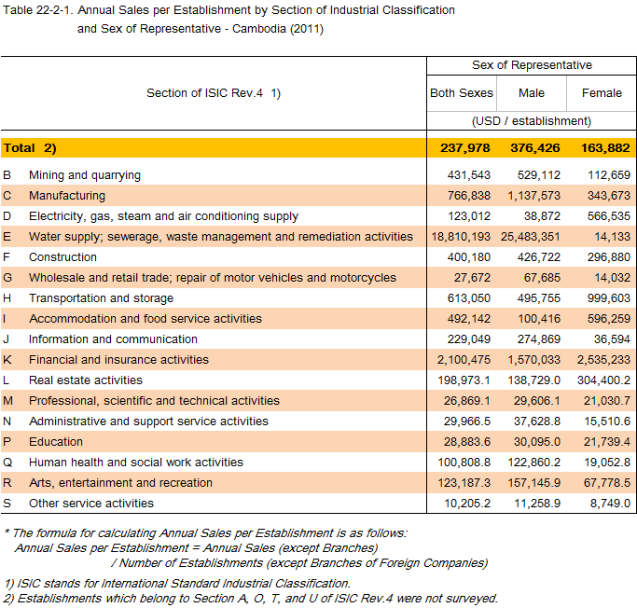

Slide 10
Annual Sales per Establishment by Section of Industrial Classification and Sex of Representative - Cambodia (2011)

Slide 11
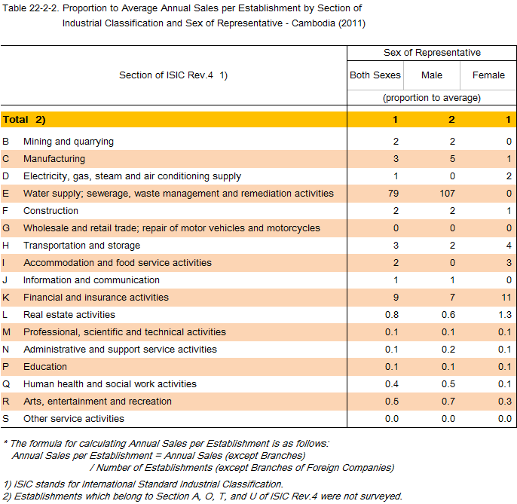

Slide 12
Proportion to Average Annual Sales per Establishment by
Section of Industrial Classification and Sex of Representative - Cambodia (2011)

Slide 13
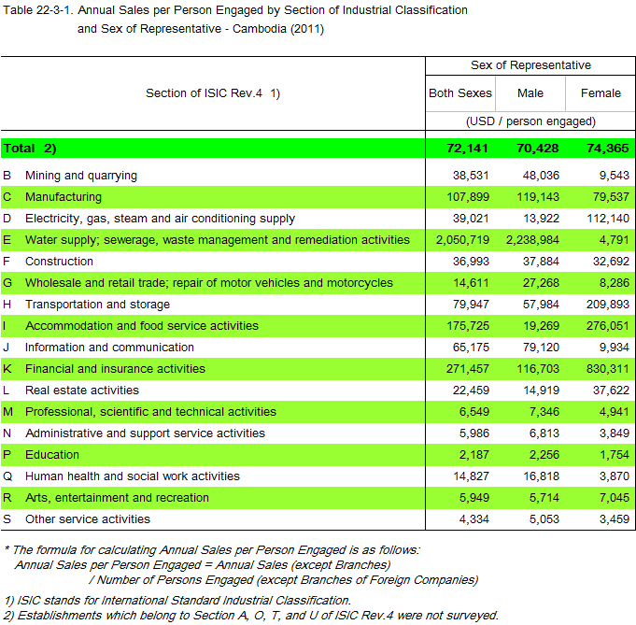

Slide 14
Annual Sales per Person Engaged by Section of Industrial Classification and Sex of Representative - Cambodia (2011)

Slide 15
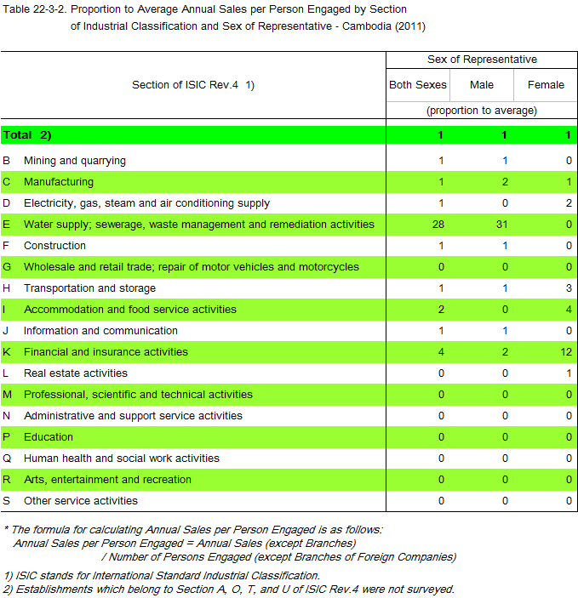

Slide 16
Proportion to Average Annual Sales per Person Engaged by
Section of Industrial Classification and Sex of Representative - Cambodia (2011)
B. Mining and quarrying C. Manufacturing
D. Electricity, gas, steam E. Water supply;
F. Construction
G.Wholesale and retail
H.Transportation and
I. Accommodation and
J. Information and
K. Financial and
L. Real estate activities M.Professional,scientifiN. Administrative and
P. Education
Q. Human health and
R. Arts, entertainment
S.Other service activities

Slide 17
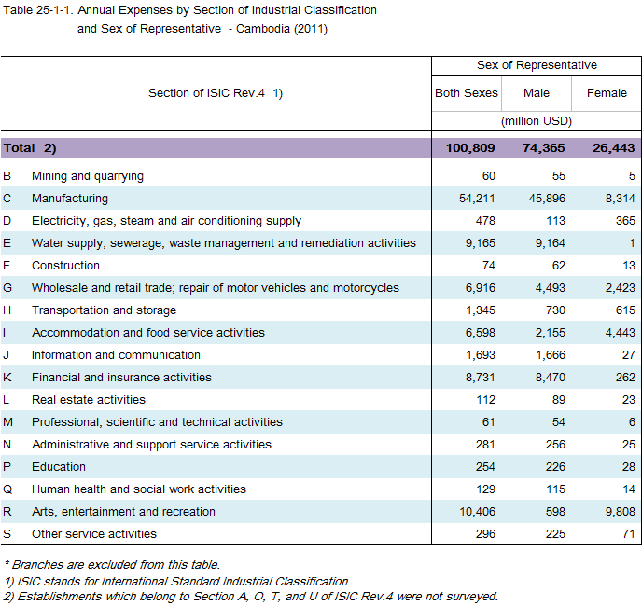

Slide 18
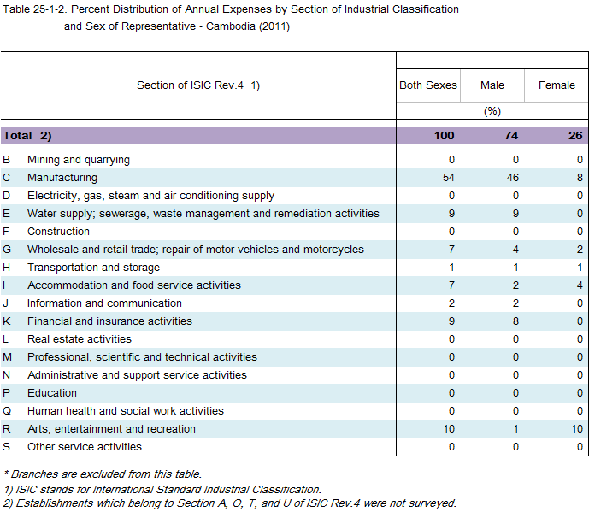

Slide 19
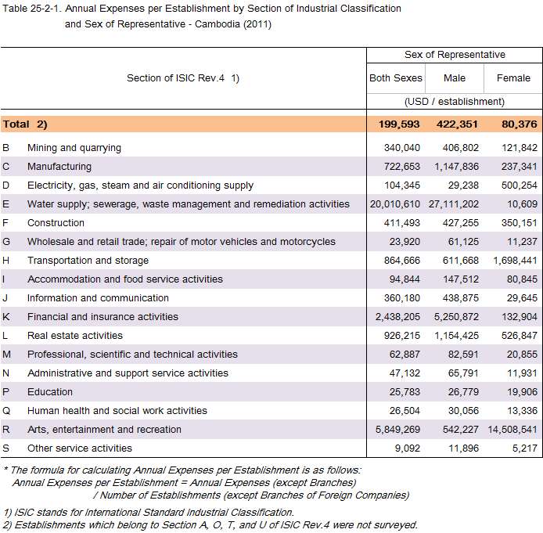

Slide 20
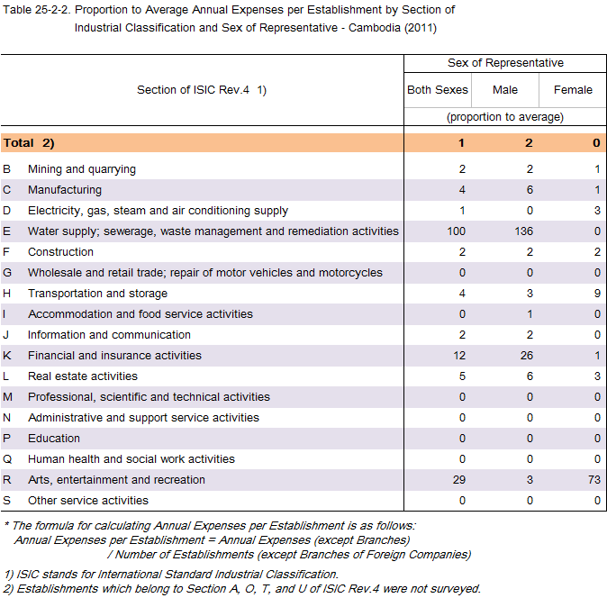

Slide 21
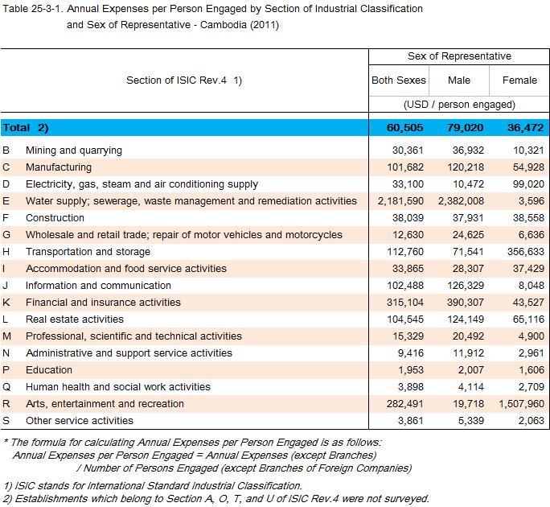

Slide 22
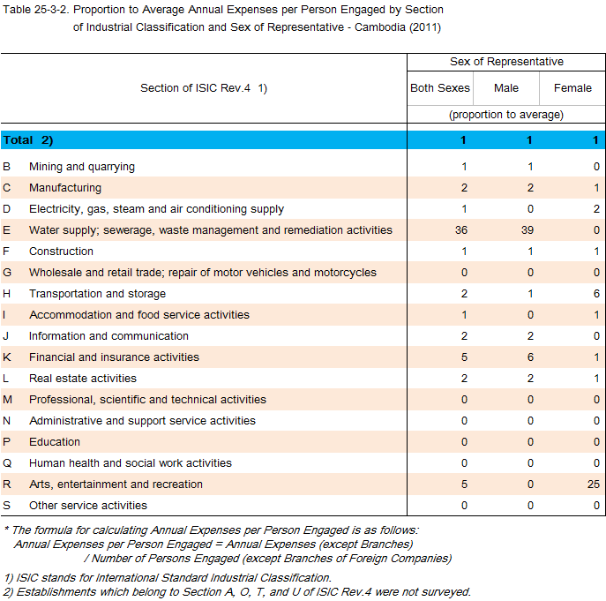

Slide 23
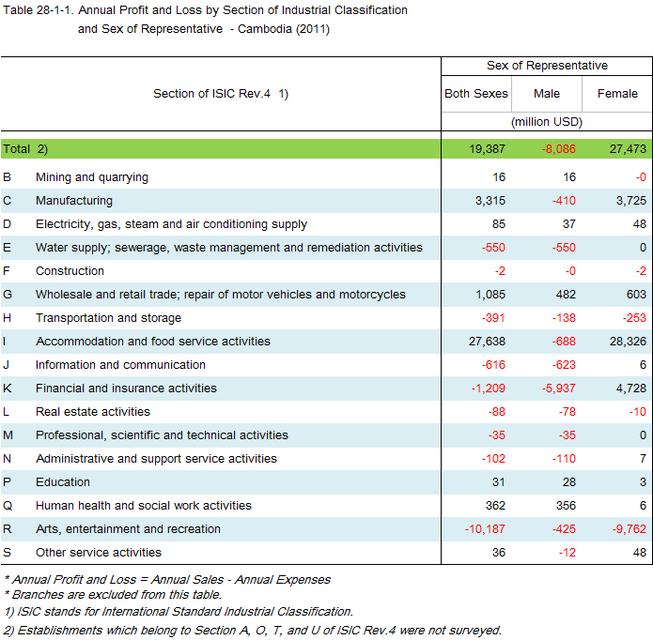

Slide 24
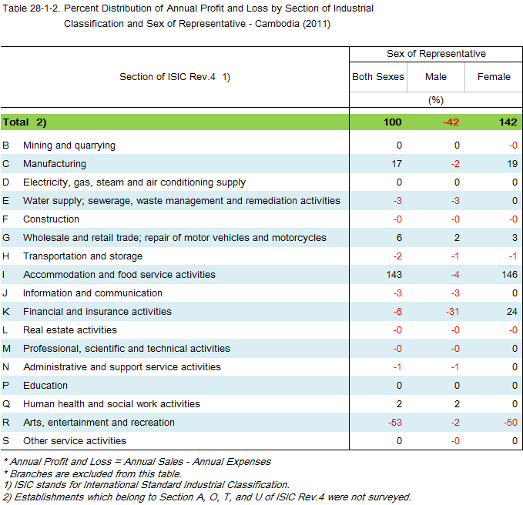

Slide 25
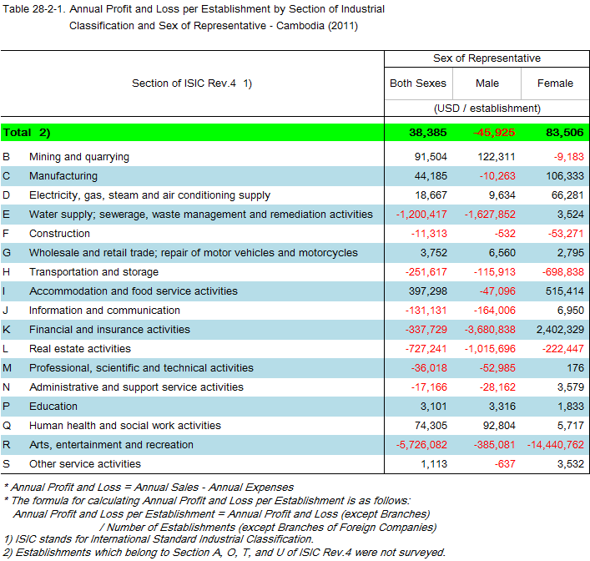

Slide 26
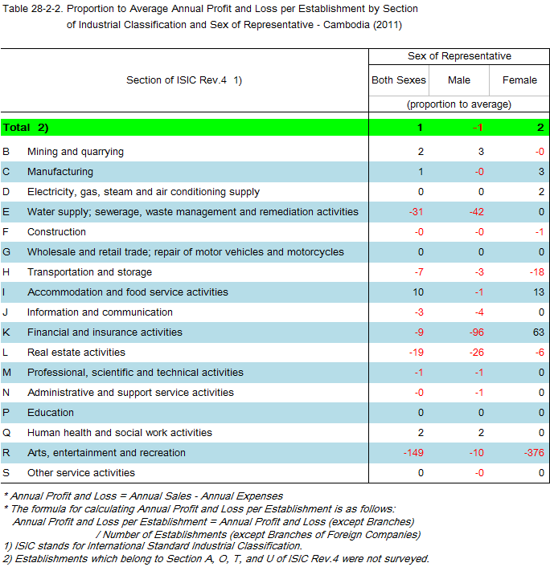

Slide 27
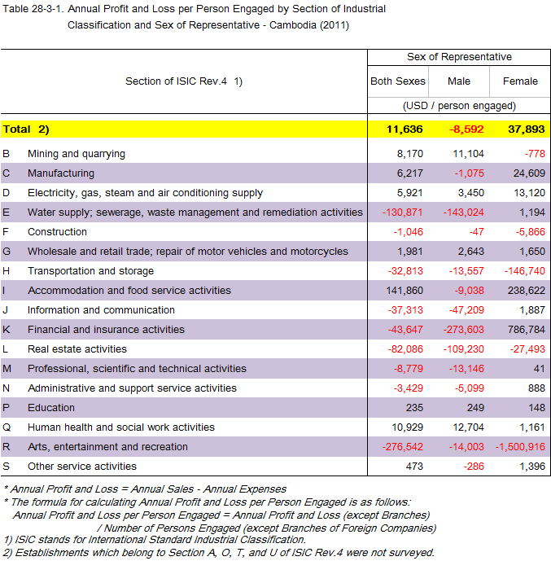

Slide 28
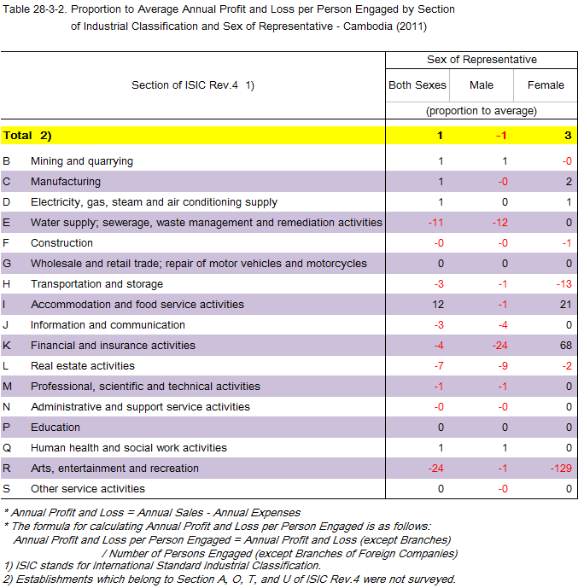

Slide 29
Business Condition in Cambodia
Annual Sales is | USD 120 billions
Annual Expenses is | USD 101 billions
Profit & loss | USD 19 billions

Slide 30
Conclusion
To enhance domestic production and break away from this high- cost economy is an important issues in future for the further socio-economic development of Cambodia.
(Refer to table 21-1, 24-1 and 27-1.)
Future investment
Legal
Next election

Slide 31

សូមអរគុណ
Thank you for your attention

Slide 32

Q & A

